Slide 1

Campus Placement Data Analysis: Unveiling Trends and Insights
This presentation analyzes campus placement data from a cohort of 215 students, revealing valuable insights and actionable strategies for improving placement outcomes.

Slide 2
Understanding the Data: A Comprehensive View
Demographics
Educational Background
Placement Details
The data includes student counts, gender distribution, and their 12th-grade streams. This provides insights into the student population.
We examine fields of study, specializations, and prior work experience. Understanding these factors helps us identify skills and preferences.
We analyze the placement status (placed or not placed) and salary data, including average, median, and maximum salaries.

Slide 3

Data Validation: Ensuring Accuracy and Completeness
Complete Data Entries
Duplicate Removal
We meticulously checked for missing values, ensuring that all records have complete and accurate information. This guarantees a reliable dataset.
We identified and removed any duplicate rows, ensuring that each student's information is represented only once. This eliminates potential bias.
Numerical Data Verification
Categorical Data Consistency
We verified that the numerical data, such as salary, falls within expected ranges. This validates the realism of the data.
We ensured that all categorical data, including gender and streams, is correctly coded without typos. This prevents misinterpretation.

Slide 4

Data Analysis: Unveiling Key Trends and Patterns
1
2
3
Univariate Analysis
Bivariate Analysis
Multivariate Analysis
We used pie charts and bar charts to analyze the distribution of fields/streams, 12th-grade streams, and specialization counts. This provides a foundational understanding of the data.
Bar charts and stacked bar charts were used to analyze relationships between gender and placement status, specialization and work experience. This reveals key correlations.
Combination charts and dynamic filters were employed to analyze the interplay of salary trends, placement status, gender, field, specialization, and experience. This unveils complex relationships.

Slide 5

Key Insights: Shaping Placement Strategies
Field/Stream Distribution
Specialization Impact
The majority of placed students come from Commerce & Management, highlighting the importance of this field.
Marketing & Finance specialization consistently outperforms Marketing & HR in placement rates and average salaries.
Gender Disparity
Work Experience
While females have a higher placement rate overall, males tend to earn higher salaries in specific specializations, highlighting the need for addressing gender equity in salaries.
Prior work experience does not appear to be a significant factor in placement outcomes, as both experienced and inexperienced students are placed.

Slide 6
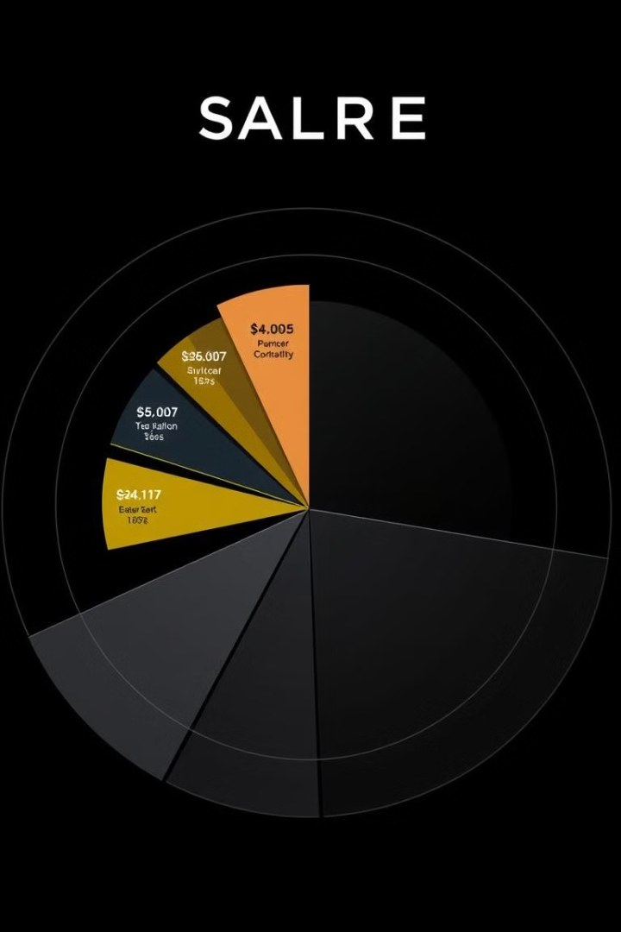
Salary Analysis: Understanding Compensation Trends
288.66K
Average Salary
The average salary stands at ₹ 288.66K, showcasing the overall compensation levels.
265K
Median Salary
The median salary of ₹ 265K provides a more balanced view of typical earnings.
940K
Maximum Salary
The maximum salary of ₹ 940K highlights the potential for high-paying offers.

Slide 7





Recommendations: Optimizing Placement Strategies
Enhance Specialization Programs
1
Strengthen programs in high-demand specializations like Marketing & Finance to ensure greater success.
2
Address Gender Disparity
Implement initiatives to bridge the gap in salary differences, promoting gender equity in placements.
3
Promote Career Counseling
Enhance career counseling services to equip students with effective job search and interview skills.
Develop Industry Partnerships
4
Foster strong partnerships with industry leaders to create more internship and job opportunities.
Data-Driven Strategies
5
Continuously analyze and leverage data insights to refine placement strategies and optimize outcomes.

Slide 8

Conclusion: Driving Future Success
By understanding the data and implementing actionable recommendations, we can create a more inclusive and effective campus placement program that empowers students to achieve their career aspirations.

